Slide 1
Cochrane: the next decade
David Tovey Editor in Chief

Slide 2
Plan
Why is evidence important?
Introduction to Cochrane
Challenges for systematic review producers
Cochrane Strategy to 2020
Looking forward for evidence informed health care
Conclusion
Notes:
Thank you for generous invitation and for giving up your time to meet me.
I hope that will have opportunity to have a two way conversation
In my presentation I will say a few words about each of the items on this slide.

Slide 3
Plan
Why is evidence important?
Introduction to Cochrane
Challenges for systematic review producers
Cochrane Strategy to 2020
Looking forward for evidence informed health care
Conclusion

Slide 4
Trust in medicine
Compassion
Competence
Shared power
Personal care
Realism
Notes:
In 1999 I attended a talk given by Professor Per Fugelli, Prof of Social Medicine in Olso. It has an enrmous impact on me and my career.
The subject was Trust between patients and doctors, Prof Fugelli descrbied the building blocks of trust

Slide 5
Trust in medicine
Compassion
Competence
Shared power
Personal care
Realism
Notes:
I was very taken by two of the 5 elements: shared power and realism. They influenced my practice until 2003 when I left to move to the BMJ and they are at the heart of how I see my role now. How can you have shared power with access to knowledge, and realism is central to Evidence informed health care

Slide 6
Why is evidence important?
Value for money
Patient safety
Evidence
Clinical performance
Notes:
Why is evidence so important to health systems: I would suggest that it is even more important now in times of stringency: where providers need to ensure value for money, so investing in internvetions that are proven to have benefit, and where there is so much concern to protect patient safety and to ensure that health professioanls deliver the best possible care. Evidence impacts on all these.

Slide 7
Plan
Why is evidence important?
Introduction to Cochrane
Challenges for systematic review producers
Cochrane Strategy to 2020
Looking forward for evidence informed health care
Conclusion

Slide 8
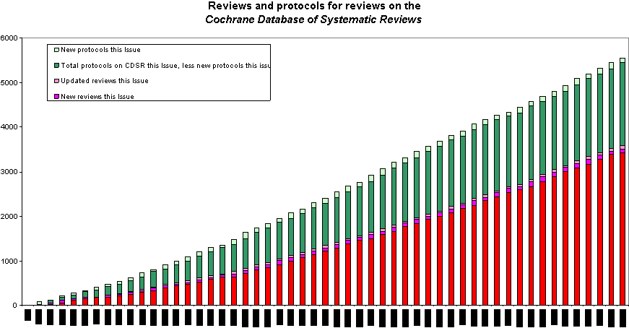
What is Cochrane?
The Cochrane Collaboration is an international organisation that aims to help people make well-informed decisions about health care by preparing, maintaining and promoting the accessibility of systematic reviews of the effects of healthcare interventions
>28,000 people >100 countries
Advocating for evidence informed decision making
Cochrane evidence used worldwide by wide range of stakeholders in diverse products and activities
Advancing the science of synthesis

Slide 9
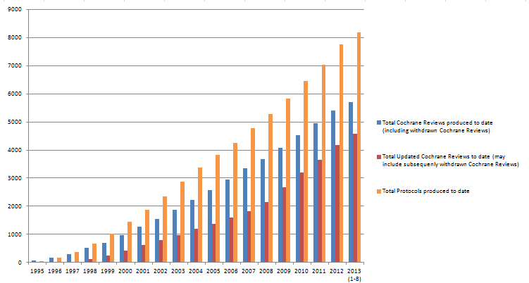
Where are we now?

Slide 10
Metrics

Slide 11
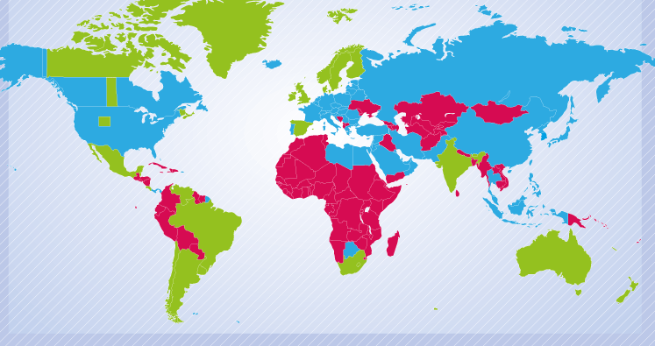
Where are we now: Access

Slide 12
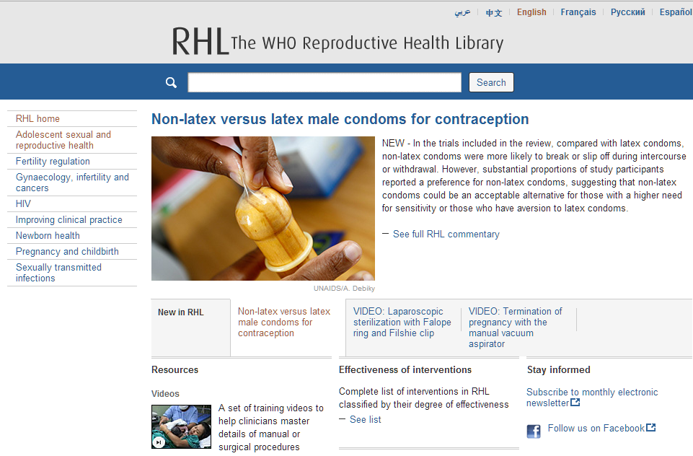
Not just The Cochrane Library

Slide 13
Not just The Cochrane Library
E-Textbooks, guidelines……
Notes:
Olus multiple other products: etxtbooks such as Dynamed, Clinical Evidence, national and international guidelines and so on

Slide 14
Where are we now: Access
Green OA model: All new and updated reviews free to access 12 months after publication Author retains copyright Reviews will be deposited in PubMed Central or equivalent
Notes:
NB Also reviews such as those published under specific programme grants and reviews with authors working for organisations where OA is mandated, e.g. NIH, Wellcome

Slide 15
Where are we now?
Green OA model: All new and updated reviews will be free to access 12 months after publication Author retains copyright Reviews will be deposited in PubMed Central or equivalent
Gold OA model:
Full OA “author pays” model Creative Commons licence ie cc-by-nc

Slide 16
Open access
Green OA:
693 reviews
385 protocols
Gold OA:
15 reviews
1 protocol

Slide 17
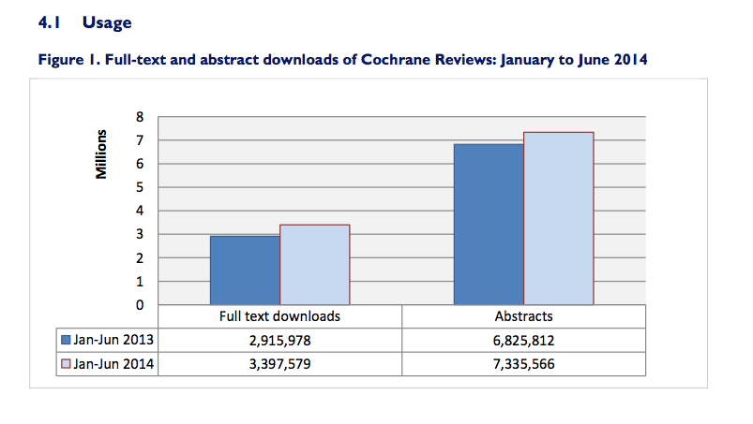
Where are we now: Impact

Slide 18
Impact

Slide 19
Impact

Slide 20
Impact
Reviews published since 2011¹
76 reviews have been published in 3 guidelines
20 reviews in 4 guidelines
6 reviews in 5 guidelines
1 review in 6 guidelines
1 review in 7 guidelines
¹Ann Eisinga, UKCC figures

Slide 21
Hungary
Rank | Review Title
1 | Spinal manipulative therapy for low-back pain
2 | Daily oral iron supplementation during pregnancy
3 | Colloids versus crystalloids for fluid resuscitation in critically ill patients
4 | Statins for the primary prevention of cardiovascular disease
5 | Vaccines for preventing influenza in healthy adults
6 | Vitamin D supplementation for women during pregnancy
7 | Early skin-to-skin contact for mothers and their healthy newborn infants
8 | Vitamin C for preventing and treating the common cold
9 | Interventions for preventing obesity in children
10 | Interventions for visual field defects in patients with stroke

Slide 22
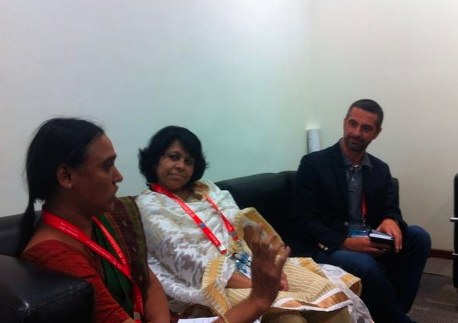
Two noteworthy reviews
Tamiflu
Avastin
And one very nice email..
Notes:
Avastin (bevacizumab) and Lucentis (ranibizumab)

Slide 23
Plan
Why is evidence important?
Introduction to Cochrane
Challenges for systematic review producers
Cochrane Strategy to 2020
Looking forward for evidence informed health care
Conclusion

Slide 24
Challenges
Reporting bias
Increased expectations of funders and users
Complexity
Timeliness
Open access
Knowledge translation / dissemination
Notes:
Don’t have to say much here – alll covered later

Slide 25
Plan
Why is evidence important?
Introduction to Cochrane
Challenges for systematic review producers
Cochrane Strategy to 2020
Looking forward for evidence informed health care
Conclusion

Slide 26
Notes:
Say something about 20th Anniversary. Moving into adulthood. No longer pioneers but still have important contribution to make as an international, independent producer of high quality SRs

Slide 28
PRODUCING EVIDENCE
MAKING OUR EVIDENCE ACCESSIBLE
ADVOCATING FOR EVIDENCE
BUILDING AN EFFECTIVE AND SUSTAINABLE ORGANISATION

Slide 29
PRODUCING EVIDENCE

Slide 30
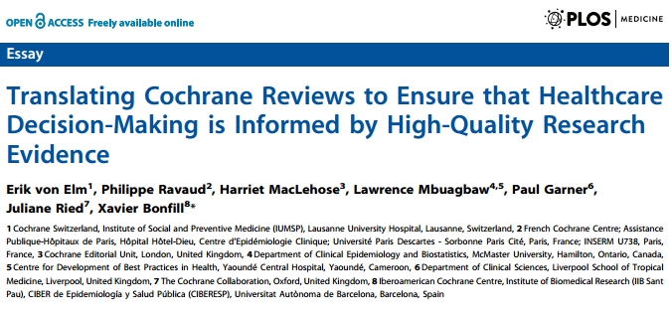
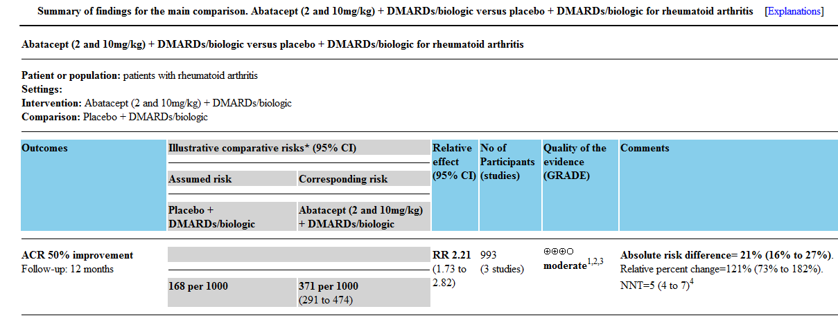
MAKING OUR EVIDENCE ACCESSIBLE

Slide 31
ADVOCATING FOR EVIDENCE
BUILDING AND EFFECTIVE AND SUSTAINABLE ORGANISATION

Slide 32
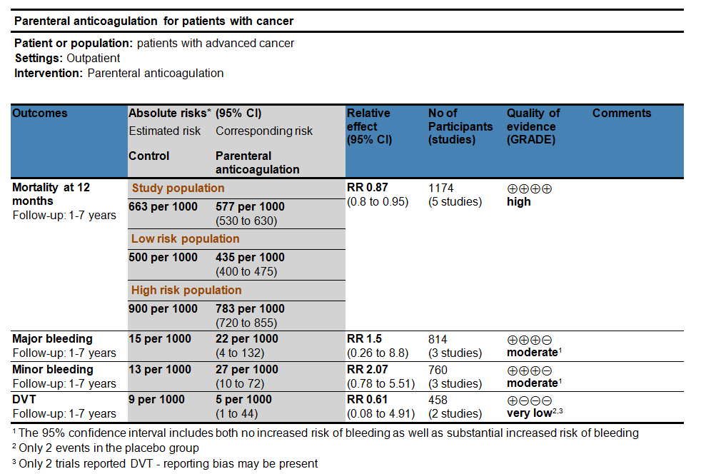
Making evidence accessible
Notes:
Tell story about Clinical Evidence here

Slide 33
What are the key elements
Sorted by clinical outcomes that matter
Takes into consideration issues that increase/decrease our confidence in the results
Report “relative” and “absolute” effects
Move away from p<0.05 to “minimum important difference”

Slide 34
Making evidence accessible: translations

Slide 35
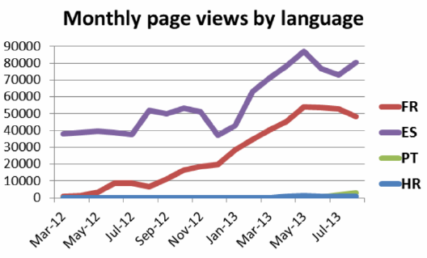
Making evidence accessible: translations
Notes:
4th highest group of users are people from francophone countries
If you produce content for people in their own language, people will come to you

Slide 36
Plan
Why is evidence important?
Introduction to Cochrane
Challenges for systematic review producers
Cochrane Strategy to 2020
Looking forward for evidence informed health care
Conclusion

Slide 37
What does future EBM look like?
Changing Reviews
Methods and quality
Enhanced reviews
New review types
Different ways of producing reviews
Different ways to present and deliver reviews

Slide 38
Different forms of analysis
Reviews of complex interventions
Network meta-analysis
Qualitative synthesis
Economic analyses

Slide 39
Enhanced reviews
Greater inclusion of non randomised studies
Review enhancements: qualitative, economic evidence

Slide 40
New review types
New review types: more diagnosis, reviews of data from clinical study reports
New types of questions: prognosis, mixed methods, qualitative and economic

Slide 41
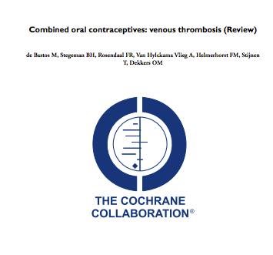
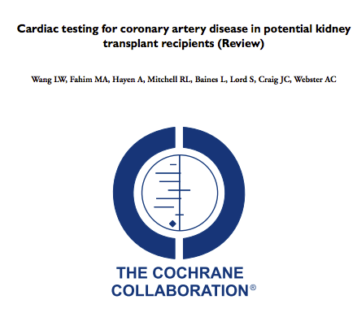
New models

Slide 42
New models

Slide 43
The “living review”
Increased use of technology
Data sharing
Wiki reviews and crowd-sourcing

Slide 44
The “living review”
"How much of what you do would be different if we could achieve even a 1 log (90%) reduction in time to produce a review or a review update?“
Julian Elliott

Slide 45
The “living review”
The Living Review Project focuses on work in three areas:
Communities of practice that support large and diverse expert, non-traditional and crowd sourced contribution of linked, open data.
Software tools that make high quality evidence review processes simpler and more efficient.
Review and meta-analytical methods that enable more efficient processes and more frequent updating.
(http://www.ntri.org.au/knowledge-hub/165?tmpl=component)

Slide 46
Different vehicles
Biologic | Control group risk | Biologic risk
Aatacept | 207 per 1000 | 474 per 1000
Adalimumab | 207 per 1000 | 631 per 1000
Anakinra | 207 per 1000 | 271 per 1000
Etanercept | 207 per 1000 | 607 per 1000
Infliximab | 207 per 1000 | 447 per 1000
Rituximab | 207 per 1000 | 604 per 1000

Slide 47
Different vehicles

Slide 48
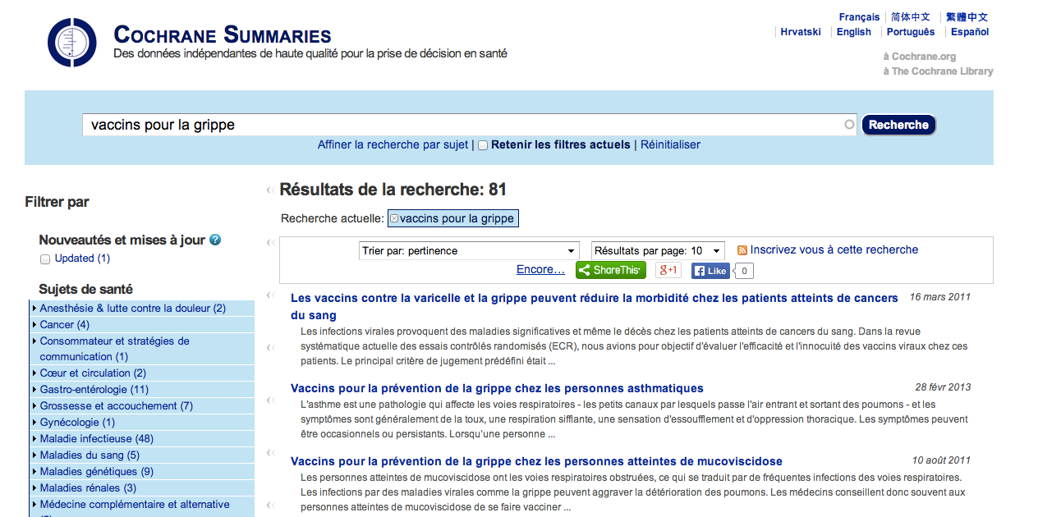
Multiple languages

Slide 49
Conclusion
Exciting times for evidence
Reporting bias
Complexity versus timeliness
Right question
Accessibility & utility

Slide 50
Köszönöm, hogy meghallgattak dtovey@cochrane.org

